Slide 1
Maintaining parallelism in reverse-mode automatic differentiation on functional parallel array languages
Public defense thesis
Simon van Hus
6147879

Slide 2
The Main Idea
Theory
Thesis
Tracing
How does the program work?
Automatic Differentiation
Finding the derivative of the program
Parallelism
Find the derivative quickly

Slide 3
Tracing
Theory
Thesis

Slide 4
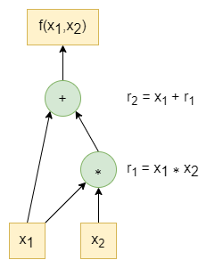
Tracing
Theory
Thesis
Single-Line program
Function Elimination
Generalized Type Elimination
13 Sep 2023

Slide 5
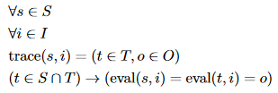
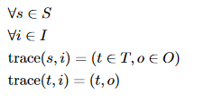
Tracing
Theory
Thesis
Generalized Type Elimination
Trace Consistency
Trace Minimalism

Slide 6
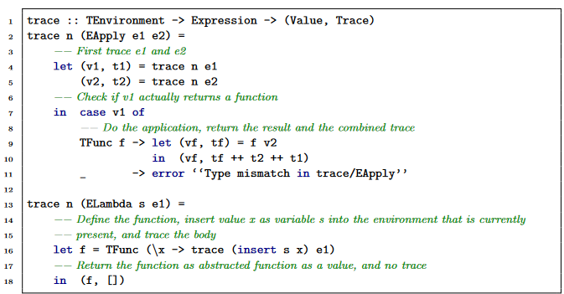
Tracing
Theory
Thesis
Function Tracing example
Insert tracing into lambda expression
Rediscover on application
Tracing Arrays
Instantiation
Map
Fold

Slide 7
Automatic Differentiation
Theory
Thesis

Slide 8
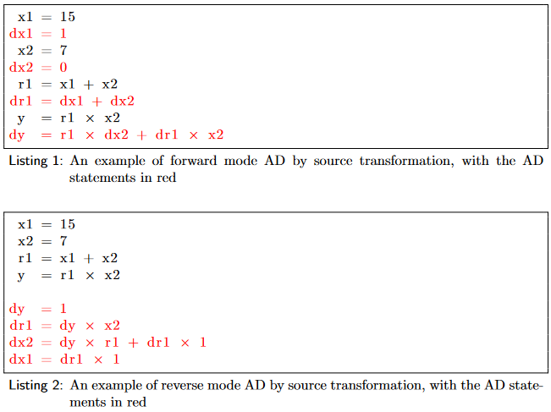
Automatic Differentiation
Theory
Thesis
By hand
Finite Differencing
Automatic Differentiation
Forward Mode
Backwards/Reverse Mode

Slide 9


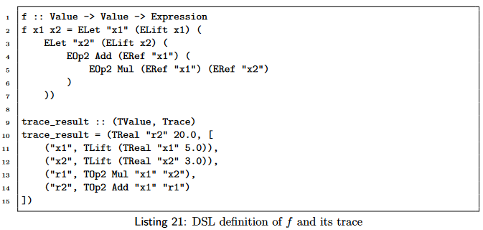
Automatic Differentiation
Theory
Thesis
Forward Pass
Operations performed
Reference counters
Intermediate values

Slide 10
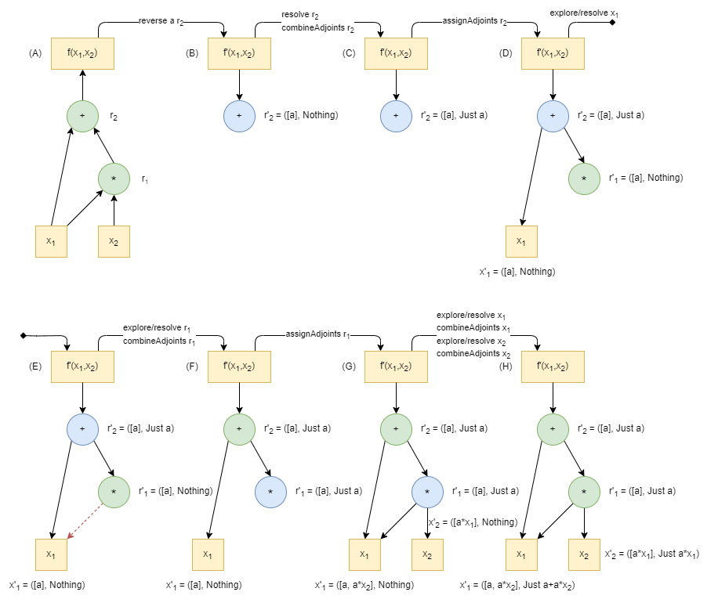
Automatic Differentiation
Theory
Thesis
Reverse Pass
Resolve node
Combine adjoints
Assign adjoints to ancestors
Explore and resolve ancestors

Slide 11
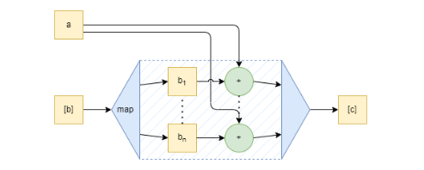
Automatic Differentiation
Theory
Thesis
Reverse Pass on arrays
Map
Fold
Closures

Slide 12
Parallelism
Theory
Thesis

Slide 13
Parallelism
Theory
Thesis
Data Parallelism
Task Parallelism
Distributed/Machine Parallelism

Slide 14
Parallelism
Theory
Thesis
Task parallelism
Concurrency
Naming
Data parallelism
Vectorization
Segmentation

Slide 15
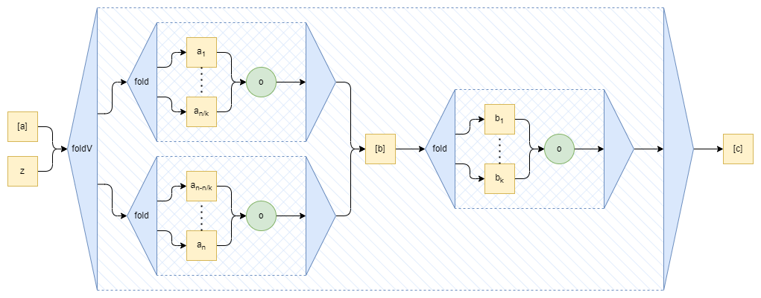
Parallelism
Theory
Thesis
Task parallelism
Concurrency
Naming
Data parallelism
Vectorization
Segmentation

Slide 16
Conclusion
Theory
Thesis

Slide 17
Conclusion
Tracing
Formal Definition, Consistency, Minimalism
Automatic Differentiation
Reference counting, intermediate values
Parallelism
Task and data parallelism

Slide 18
That’s it!
Public Thesis defense
Simon van Hus
6147879

